Slide 1

2022-23 Prior Learning Assessment (PLA) Report
Office of the Commissioner of Higher Education

Slide 2
MUS Accepted PLA Credits
Standardized Tests- AP, CLEP, DSST/DANTES, IB, Straighterline and UExcel
Challenge Exams- comprehensive exams of the course subject matter
Portfolio Assessments- students submit a portfolio showcasing their knowledge for faculty evaluation
American Council on Education (ACE) and National College Credit Recommendation Service (NCCRS)- proposes college credit equivalencies for learning outside of the college classroom
Military Credit- credits earned by branches of the US military
Experiential Learning- credits earned through work experience or learning outside of the college classroom

Slide 3
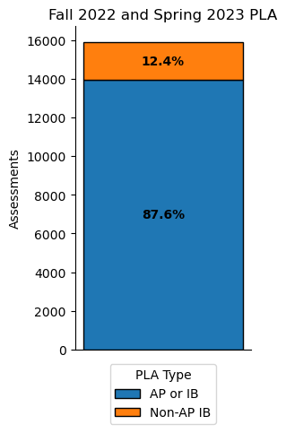
PLA by Semester
PLA Credits | Fall 2021 | Spring 2022 | Fall 2022 | Spring 2023
Advanced Placement (AP) | 6607 | 6256 | 6529 | 6198
Military | 308 | 278 | 287 | 276
Challenge | 124 | 115 | 105 | 94
College-Level Examination Program (CLEP) | 210 | 183 | 159 | 140
International Baccalaureate (IB) | 628 | 605 | 621 | 590
Other: Experiential Learning, ACE, Portfolio, Straighterline, Dantes, UExcel and Other | 455 | 448 | 464 | 448
Total | 8332 | 7885 | 8165 | 7746
8,050 students were awarded credit in 2022-23

Slide 4
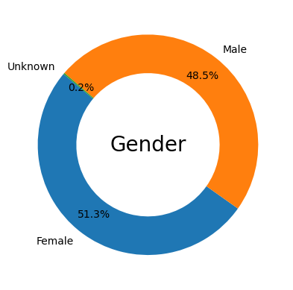
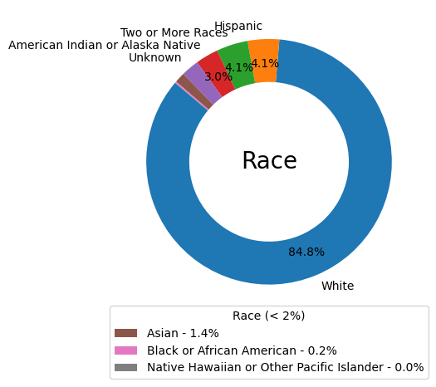
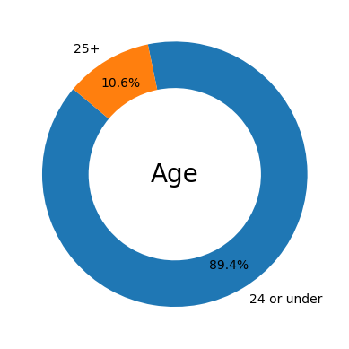
2022-23 PLA Student Demographics

Slide 5
2022-23 PLA Demographics Compared
Demographics | All PLA | AP & IB | Non-AP/IB
Female | 51% | 53% | 39%
Male | 49% | 47% | 61%
24 or under | 89% | 93% | 62%
25+ | 11% | 7% | 38%
White | 85% | 86% | 79%
Hispanic | 4% | 4% | 7%
Two or More Races | 4% | 4% | 3%
American Indian or Alaska Native | 3% | 3% | 5%
Unknown | 2% | 2% | 5%
Asian | 1% | 1% | 1%
Black or African American | 0% | 0% | 1%
Native Hawaiian or Other Pacific Islander | 0% | 0% | 0%
Non-Veteran | 95% | 98% | 72%
Veteran | 5% | 2% | 28%

Slide 6
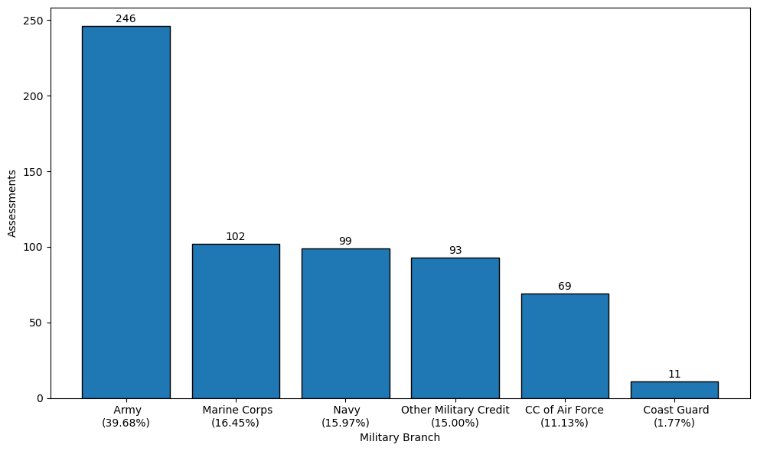
2022-23 Military Credits by Branch
369 out of 502 (73.5%) of veteran students that were awarded PLA credits used military transcripts in 2022-23

Slide 7
2022-23 PLA by Campus
PLA | City College | Dawson CC | Flathead Valley CC | Gallatin College | Great Falls College | Helena College | Highlands College | MSU- Northern | MSU-Billings | MSU-Bozeman | MT Tech | Miles CC | Missoula College | UM-Missoula | UM-Western | Total
Advanced Placement (AP) | 51 | 13 | 454 | 176 | 25 | 47 | 40 | 41 | 238 | 8305 | 447 | 0 | 142 | 2621 | 127 | 12727
Challenge | 11 | 0 | 13 | 0 | 13 | 8 | 20 | 0 | 58 | 33 | 34 | 0 | 0 | 8 | 1 | 199
College-Level Examination Program (CLEP) | 4 | 0 | 13 | 0 | 14 | 0 | 0 | 0 | 17 | 209 | 4 | 0 | 6 | 26 | 6 | 299
International Baccalaureate (IB) | 0 | 0 | 199 | 4 | 0 | 0 | 0 | 2 | 8 | 623 | 21 | 0 | 40 | 308 | 6 | 1211
Military | 15 | 0 | 63 | 10 | 9 | 32 | 0 | 0 | 48 | 244 | 5 | 2 | 12 | 115 | 8 | 563
Other: Experiential Learning, ACE, Portfolio, Straighterline, Dantes, UExcel and Other | 36 | 42 | 6 | 6 | 103 | 21 | 4 | 0 | 76 | 537 | 47 | 0 | 5 | 26 | 3 | 912
Total | 117 | 55 | 748 | 196 | 164 | 108 | 64 | 43 | 445 | 9951 | 558 | 2 | 205 | 3104 | 151 | 15911

Slide 8




2022-23 PLA Statistics
24.5% of undergraduate students in MUS have PLA credits
17.2% of undergraduate students in the MUS age 25+ have PLA credits
39.4% of undergraduate veteran students have PLA credits

Slide 9
PLA Information
Website:
https://www.mus.edu/pla/
Contact:
Jacque Treaster
jtreaster@montana.edu
(406) 449-9135

